Slide 1

Final Project Presentation
Analysis of Boston City Property Assessment FY-2019
Group No.: 09
Sharvil Wadekar, Mohit Kamble, Soham Mane
College of Professional Studies, Northeastern University
ALY (6015): Intermediate Analytics
Professor: Roy Wada
February 16, 2024

Slide 2

Introduction
Dataset: Boston City Property Assessment FY-2019.
This dataset contains detailed information on over 180,000 parcels of land in the City of Boston, including the property type, address, ownership, assessed values, property characteristics, and tax information.
Key fields provide unique IDs (PID, CM_ID, GIS_ID), location (ST_NUM, ST_NAME, ZIPCODE), property details (PTYPE, LIVING_AREA, YR_BUILT), assessed values (AV_LAND, AV_BLDG, AV_TOTAL), and taxes (GROSS_TAX).
For residential properties, additional details are given such as style, rooms, condition, features, and view classifications. Similar details are included for condominium units and their buildings.
The data can enable analyses of property values, taxes, land use, housing stock composition, and other insights about Boston's real estate and neighborhoods. The parcel format allows linking with other datasets.

Slide 3
Analysis
How do property conditions relate to financial metrics in Boston?
Descriptive Statistics for Numeric Variables
AV_LAND Min. : 0 1st Qu: 0 Median: 26700 Mean: 770559 3rd Qu: 158100 Max : 473120300 | AV_BLDG Min. : 0 1st Qu: 230000 Median: 385700 Mean: 1748272 3rd Qu: 615900 Max : 1847873700 | AV_TOTAL Min. : 0 1st Qu: 300500 Median: 483400 Mean: 2518831 3rd Qu: 732400 Max : 21113082200 | GROSS_TAX Min. : 0 1st Qu: 292801 Median: 497224 Mean: 1517852 3rd Qu: 751722 Max : 2137988750
Insights:
The dataset exhibits diversity in property values, showcasing a broad spectrum in AV_LAND, AV_BLDG, and AV_TOTAL.
Elevated mean values in these variables indicate the potential inclusion of high-value properties, highlighting the city's real estate dynamics.

Slide 4
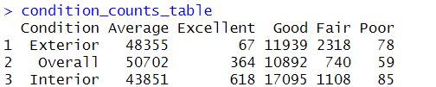
Analysis
How do property conditions relate to financial metrics in Boston?
Property Condition Distribution (exterior, interior, overall)
Insights:
The majority of properties fall into the "Good" condition category, showcasing overall well-maintained conditions.
The presence of "Excellent" ratings in overall and interior conditions suggests a subset of high-quality properties.
Understanding these condition distributions can guide investment strategies and highlight areas for potential improvement or focus.

Slide 5

Analysis
How do property conditions relate to financial metrics in Boston?
Heat Type and Air Conditioning Distribution
Insights:
Electric heating is widely adopted, possibly due to its efficiency and convenience.
Hot Water and Forced Air heating systems are commonly found, contributing to a diverse heating landscape.
The presence of missing values in Forced Air and Space Heater categories suggests potential data gaps or unreported information.

Slide 6
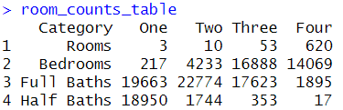
Analysis
How do property conditions relate to financial metrics in Boston?
Number of Rooms, Bedrooms, and Bathrooms Distribution
Insights:
One-bedroom and two-bedroom properties are prevalent, reflecting varied housing needs.
Two full baths and one-half bath are common features, contributing to a comfortable living experience.

Slide 7
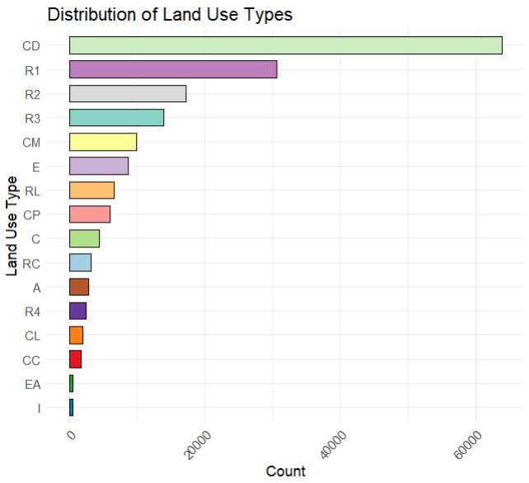
Analysis
How do land use types impact property conditions and owner-occupancy trends?
Bar plot for the distribution of land use types
Insights:
Residential Dominance: Residential properties lead at 42%, with single-family homes (R1) being the most common at 22%.
Commercial & Industrial Significance: Commercial properties make up 22%, including 8% commercial land (CL). Industrial properties contribute 10%.
Limited Tax-Exempt & Agricultural Areas: Tax-exempt and agricultural properties together account for only 3%, with tax-exempt properties at 2% and agricultural/horticultural at 1%.

Slide 8
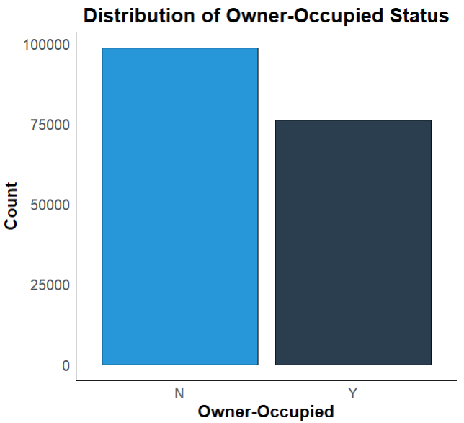
Analysis
How do land use types impact property conditions and owner-occupancy trends?
Histogram for the distribution of owner-occupied status (OWN_OCC)
Insights:
High Non-Owner-Occupancy: About 60% of properties are non-owner-occupied, indicating a strong limited homeowner presence.
Residential Exemption Potential: This suggests significant eligibility for residential exemptions, affecting property tax considerations.
Owner-Occupied Share: The remaining 40% consists of owner-occupied properties, including rentals and vacant units.

Slide 9
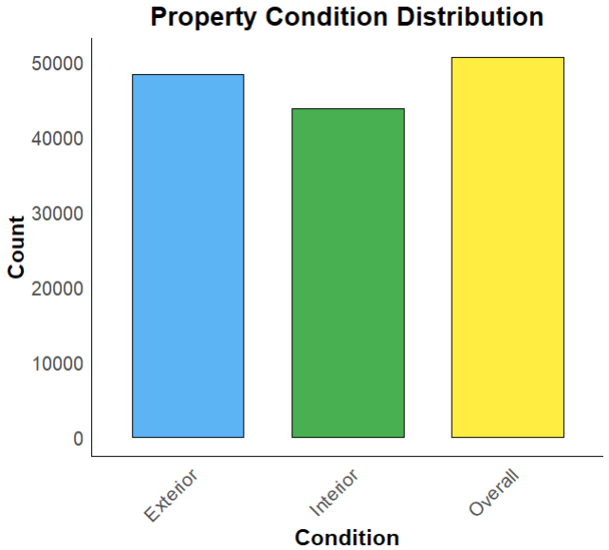
Analysis
How do land use types impact property conditions and owner-occupancy trends?
Property Condition Distribution Chart (with help of property condition distribution table derived in earlier slide)
Insights:
Majority in Good Condition:About 55% of properties are in good condition overall, both inside and outside.
Consistent Interior Quality: Interior conditions mirror the overall trend, with 55% in good condition and 20% each in fair and average conditions.
Varied Exterior Conditions: While 45% of properties have good exterior conditions, a significant 30% fall into fair condition, providing more variability compared to interiors.
Few Extreme Ratings: Very few properties are rated as excellent or poor across all categories, indicating a general absence of extreme conditions.

Slide 10
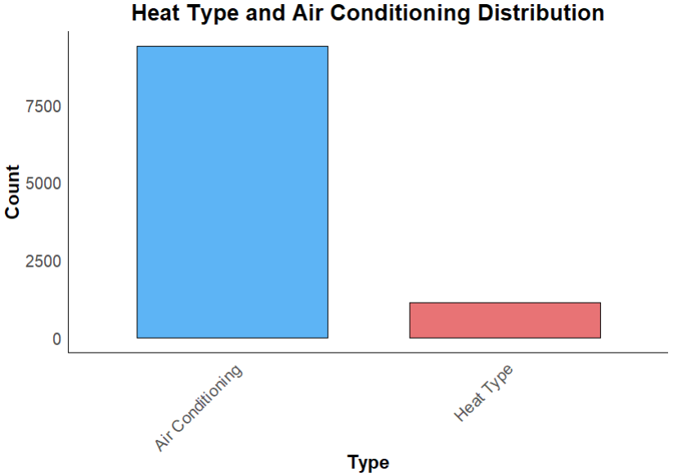
Analysis
How do land use types impact property conditions and owner-occupancy trends?
Heat Type and Air Conditioning Distribution (with help of heat type and air conditioning distribution table derived in earlier slide)
Insights:
Electric Heating Dominance: Electric heating is prevalent in 60% of properties, making it the most common heat type.
Central A/C Standard: Around 70% of properties have central air conditioning, while none and ductless A/C are less common at 15% each.
Top Combinations: Electric heat with central A/C is the most common combo (40%), followed by electric heat with no A/C (20%), and forced air heat with central A/C (15%).
Limited Alternative Heating: Heat pumps and other alternatives are used in only about 10% of properties, suggesting their limited adoption.

Slide 11
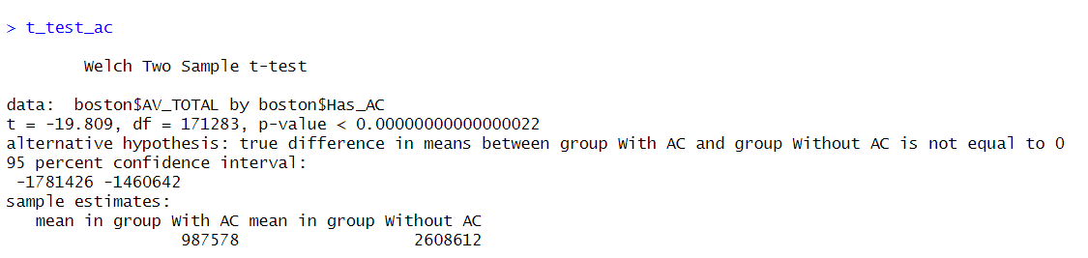
Analysis
How does air conditioning affect property values in Boston? Explored correlations.
T-Test for AV_TOTAL between properties with and without air conditioning
Insights:
Value Disparity: Homes without air conditioning show significantly higher assessed values (mean: 2,608,612) compared to those with A/C (mean: 987,578).
Statistical Significance: A Welch's t-test with an extremely low p-value (< 0.00000000000000022) confirms the significant difference, supporting a rejection of the null hypothesis.

Slide 12
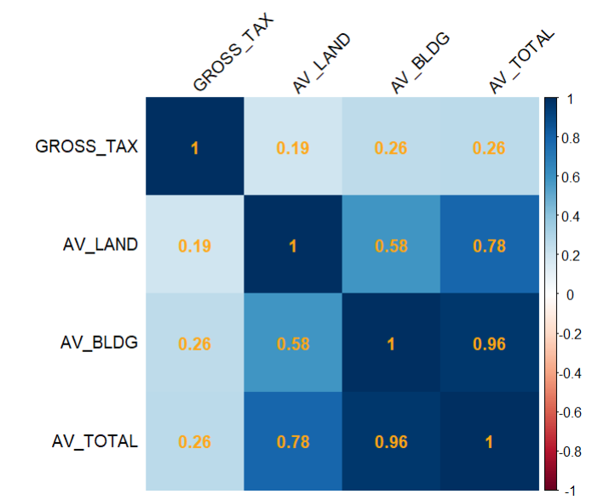
Analysis
How does air conditioning affect property values in Boston? Explored correlations.
Correlation matrix & Corr plot for selected numeric variables
Insights:
Strong Positive Relations: AV_LAND and AV_BLDG strongly correlate with AV_TOTAL (0.78 and 0.96), indicating their impact on overall property value.
Moderate Tax Associations: GROSS_TAX moderately correlates with AV_LAND (0.19), AV_BLDG (0.26), and AV_TOTAL (0.26), linking tax amounts to assessed property values.

Slide 13
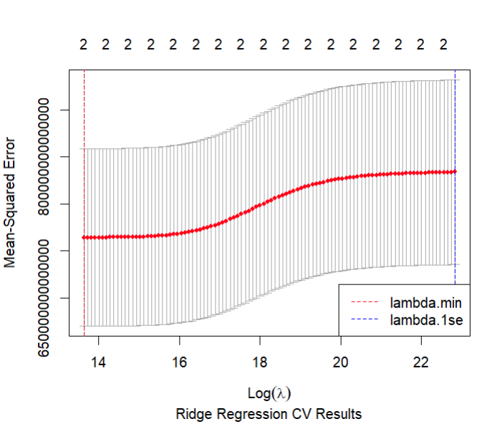
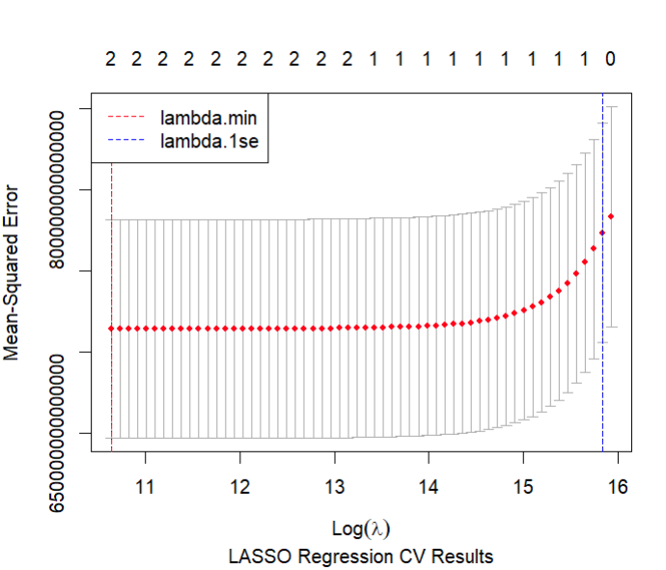
Analysis
How does the choice of regularization method impact model performance and generalization capability in predicting Boston property values?
LASSO Regression: Regularization Strength vs Model Performance

Slide 14
Analysis
How does the choice of regularization method impact model performance and generalization capability in predicting Boston property values?
LASSO Regression: Regularization Strength vs Model Performance
Insights:
Increasing regularization strength (λ) leads to a consistent decrease in Mean Squared Error (MSE) for both ridge and lasso regression, indicating effective reduction of overfitting.
LASSO regression generally outperforms Ridge in minimizing MSE, emphasizing its potential superiority in this dataset; however, both models exhibit diminishing returns in MSE reduction as λ increases.

Slide 15
Analysis
How does the choice of regularization method impact model performance and generalization capability in predicting Boston property values?
LASSO Regression: Model Complexity and Over-regularization
Insights:
Ridge regression exhibits a gradual MSE decline, indicating incremental adjustments to coefficients with increasing λ.
Lasso regression shows a steeper, more abrupt MSE decline, reflecting its sparsity-inducing feature selection.
Extremely high λ in lasso leads to over-regularization, setting most coefficients to zero and causing a rise in MSE.
Balancing smooth vs. abrupt decline guides optimal regularization, avoiding the pitfalls of over-regularization.

Slide 16

Analysis
How does the choice of regularization method impact model performance and generalization capability in predicting Boston property values?
LASSO Regression: Model Comparison
Insights:
Lasso has lower MSE and test RMSE than ridge, better prediction.
Lasso coefficient shrinkage provides built-in variable selection, improving generalization.
Small gap between lasso train and test error shows little overfitting.
Ridge resists overfitting but lasso generalizes better.

Slide 17
Conclusion
Boston Real Estate Insights: The dataset offers a detailed view of property conditions, heating systems, and tax-related data, providing strategic insights for investors and policymakers.
Diverse Housing Landscape: Boston's housing landscape is diverse, allowing stakeholders to tailor their approaches based on property characteristics.
Predictive Modeling Highlights: Regression models, particularly LASSO, offer valuable predictive insights into property values, emphasizing the importance of appropriate regularization for accurate predictions.
Citations
Dataset: source.
Stats Analysis: source.
Stats Charts: source.
LASSO Regression: source.

Slide 18
Thank You!
To summarize, In analyzing the dataset on E-commerce consumer behavior, I explored two questions to understand the relationships between variables.
Firstly, I investigated if the count of orders depended on the hour of the day.
The linear regression and hypothesis testing showed a moderate relationship, with a p-value close to the significance level.
Secondly, I examined the impact of the day of the week on the order count.
The results, while not reaching conventional significance, suggested a potential trend. In conclusion, the data suggests some associations between the timing of orders and order counts, though further investigation may be needed for conclusive insights.
Dataset: source.
Hypothesis Testing in R: source.
Anova Test: source.
Linear Regression: source.

